Slide 1

Pin Reference Concerns
Bob Ross, Teraspeed Labs bob@teraspeedlabs.com
ATM Meeting
July 12, 2016

Slide 2
Main Points
Comments on [Pin Reference] (and editorial, corrections – some strikethroughs not copied)
C_comp may be dominated by pads and metalization
Thresholds not discussed here
  Too big of a topic, but relevant for ECL
  Should not in this BIRD
What is purpose of a pin reference? (current flows or threshold reference, closest ground?)

Slide 3
Comments in Red
section → keyword
pin_name col. entry not Sub-Param
model thresholds incomplete or questionable
Delete - bus_label declarations completely described above

Slide 4
Continued
More on ECL later

Slide 5
Continued
VSS pin does not exist & change VEE to -3.2 V
Interchange VEE and VCC
Could delete [Model] but add voltage details in [Pin]
[Model]s covered later
Could add Output pin_name for second [Pin Reference] entry

Slide 6
Legal ECL Test Setup and Operation
No 0.0 V connection (or “VSS” Rail to DUT)
Supply connections are 2.0 V and -3.2 V (or -2.5 V)
Legal configuration for IBIS [Model] and [Component]

Slide 7
C_comp
ECL physical structure has dominant output circuitry is between output and Pullup_ref terminals
Unknown multi-layer metalization may contribute to dominant C_comp connection
GND (global or internal) not always best choice for C_comp reference
PECL vs. ECL would switch C_comp reference to different terminal, if not global GND

Slide 8
PECL Gate with a Normal Load
Pin Interface VCC
5.0 V
To Vout-
Vout+
50 Ω
Minimal Impact on V, I
3.0 V
VEE = GND
Slides 8-11 drawings extended figures in Maxim Integrated App. Note HFAN-06.2

Slide 9
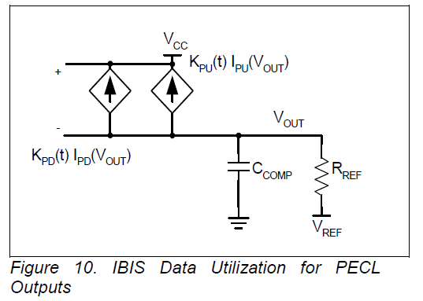
PECL IBIS Output Simulation
(Packages Not Shown)
Pin Interface
VCC = 5.0 V
5.0 V
= 50 Ω
Ground symbol could be Vee in some tools, (most negative terminal)
= 3.0 V
3.0 V
VEE = 0.0 V

Slide 10
Split PECL IBIS Output Simulation
(Packages Not Shown) No VSS Pin
Pin Interface
VCC = 2.0 V
2.0 V
= 50 Ω
Ground symbol could be Vee in some tools, (most negative terminal)
= 0.0 V
GND
3.2 V
VEE = -3.2 V

Slide 11
ECL IBIS Output Simulation
(Packages Not Shown)
Pin Interface
VCC = 0.0 V
2.0 V
5.2 V
= 50 Ω
Ground symbol could be Vee in some tools, (most negative terminal)
= -2.0 V
VEE = -5.2 V

Slide 12
Reference Rail
[Pin Reference] syntax supports any [Model] Rail terminal as a reference
[* Reference] contains exact values relative to DUT GND (A 2.0 V reference is just as valid as a 0.0 V reference)
A VSS pin (GND DUT connection) does not always exist
Current flow, voltage modulation could be dominant consideration overriding any stated defaults

Slide 13
Suggestions, Actions
Editorial changes, corrections
Change example
  Remove Pin 4, fictional VSS (does not exist)
  Perhaps add an output buffer example
  No need to show a forward referenced [Model]
Perhaps add an ECL default rule
Modelers:
  Best reference based on internal electrical circuitry
  A [* Reference] 0.0 0.0 0.0 not always best choice (current flow, cap?)
EDA vendor suggestion: Be careful using for “thresholds”

